Slide 1
Technical Areas and RTD Challenges
Jeni Tennison
Linked Data advisor for data.gov.uk

Slide 2

Getting started
catalogues & CSVs
Photo from dfulmer http://www.flickr.com/photos/annarbor/4350629792/
Notes:
publishing Excel, CSVs, machine-readable data, pointers to APIs
- registry site to collect them, enable people to search
- start to find there are problems...

Slide 3
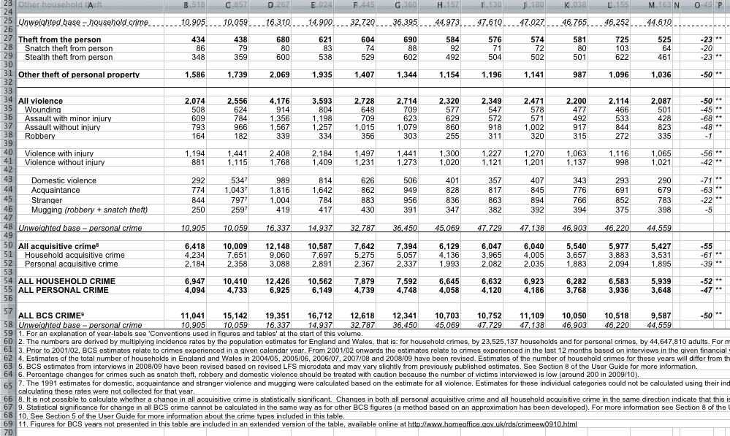
Challenges
complexity & understandability
Notes:
Government data is not tabular
- developers want tabular data they can import into a spreadsheet
- but there's a reason government publishes in Excel and PDFs
- annotations, provisos
- transport and organisational networks
- semi-structured data such as legislation
Government data is not easy to understand
- use of codes
- definitions of measures
- experts are the data owners

Slide 4

More challenges
trust & distribution
Notes:
Government data is important
- provenance matters
- versioning matters
- timeliness matters
Government data is distributed
- different public bodies produce data about the same things
- needs to be easy to integrate
- talk about things slightly differently
- may publish similar information in completely different ways

Slide 5

Linked Government Data
data like the web
Photo from fdecomite http://www.flickr.com/photos/fdecomite/1457493536/
Notes:
shared identifiers for easy integration
- including codes and column names
- increasing transparency & reusability
- for schools, hospitals, administrative areas, ...
- used consistently across datasets
- providing a hub from which information can be found
flexible data model to handle complex data
- distributed extensibility
- support for heterogenous requirements
focus on incremental improvement
- not everyone adopts at the same time
- supports evolution
- grow like the web

Slide 6

No silver bullets
remaining issues
Photo from An Nguyen Photography http://www.flickr.com/photos/annguyenphotography/3267723713/
Notes:
foreign mindset to government
- tend to like to enforce solutions big bang/top down
toolset maturity & mindshare
- working directly with RDF isn't easy (yet)
- developers (think they) prefer something simpler
- issues of versioning, trust, provenance still loom large

Slide 7
It's not enough for governments to publish data
They need to publish data well

